Slide 1
Building State-of-the-Art Forecast Systems with the Ensemble Kalman Filter Jeff Anderson representing the NCAR Data Assimilation Research Section

Slide 2
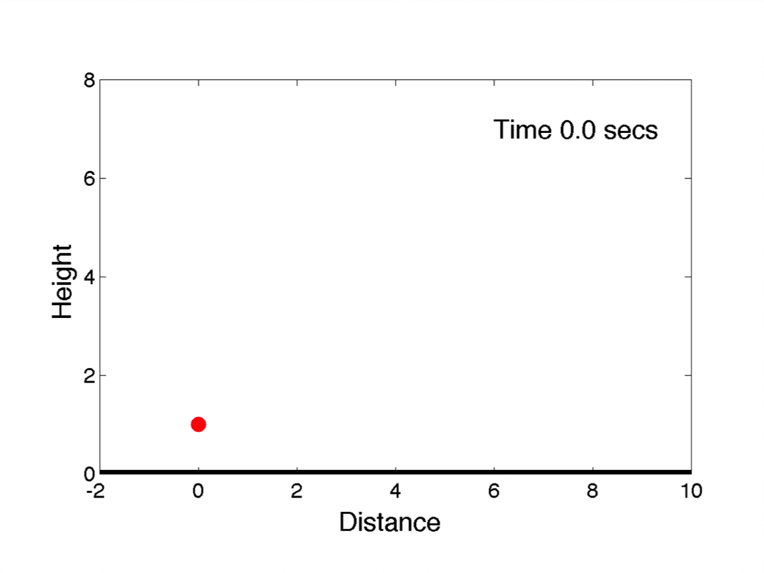
Building a Forecast System
Want to predict where the ball will land.

Slide 3
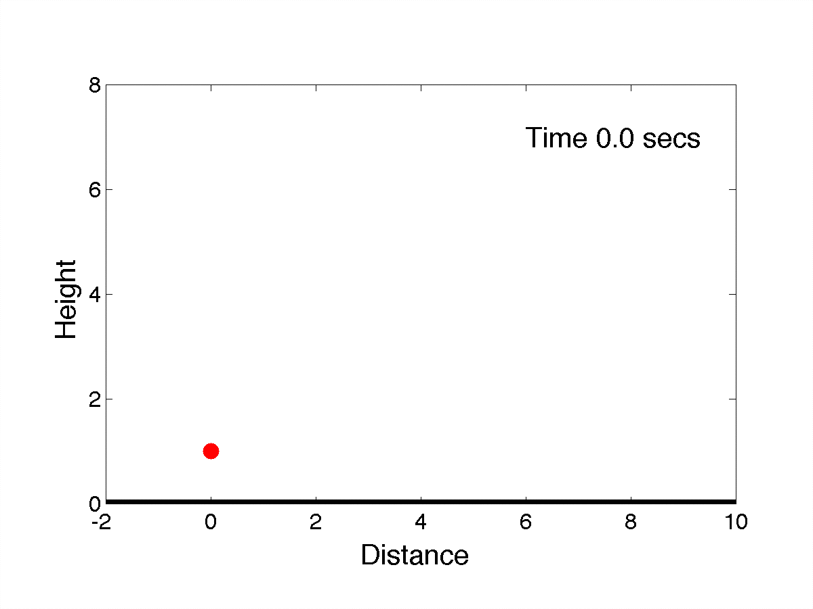

Building a Forecast System
Want to predict where the ball will land.

Slide 4
Building a Forecast System
Prediction Model

Slide 5
Building a Forecast System
Prediction Model
For the ball this is simple:

Slide 6
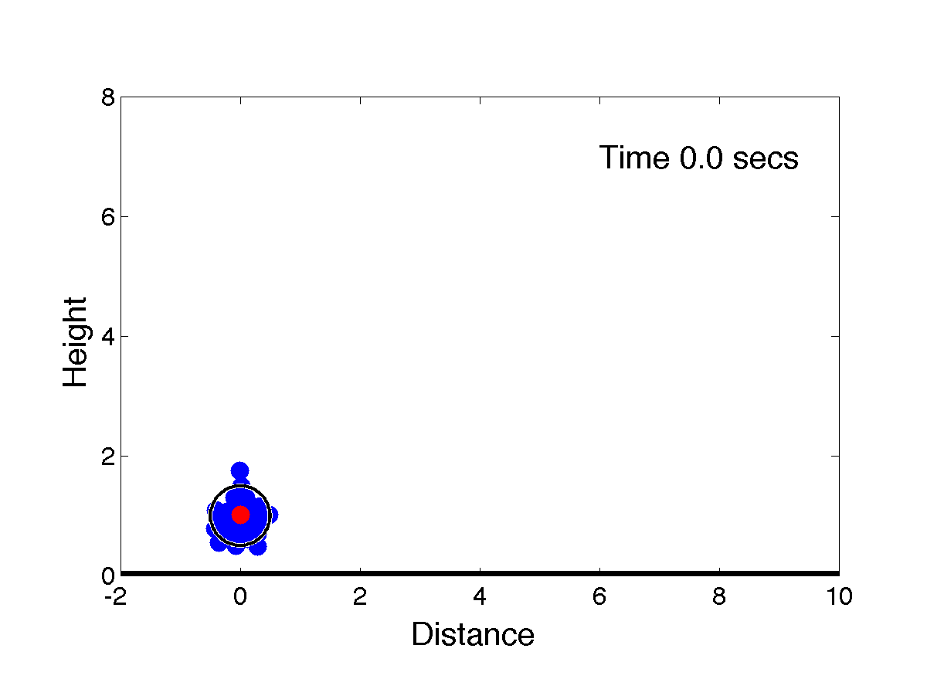
An Ensemble of Model Forecasts Shows Uncertainty
Unsure about release point, velocity, angle…
Sample this with an ‘ensemble’ of blue balls.

Slide 7

An Ensemble of Model Forecasts Shows Uncertainty
Unsure about release point, velocity, angle…
Sample this with an ‘ensemble’ of blue balls.

Slide 8
Building a Forecast System
Prediction Model
Observing System
Need observations (measurements) of the red ball.
All observations have errors.
Observe position of ball every half second after throw.

Slide 9
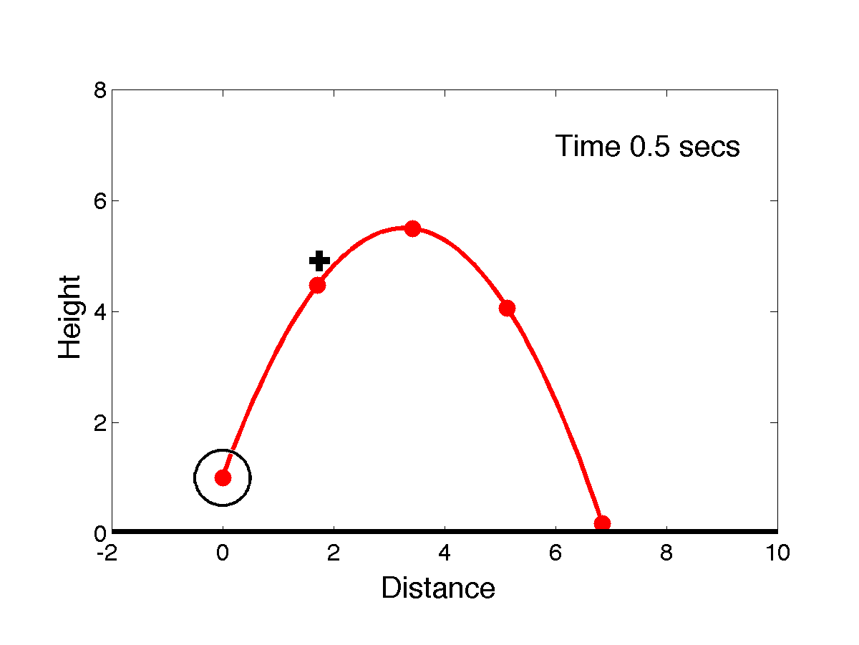
Observations of the Red Ball

Slide 10
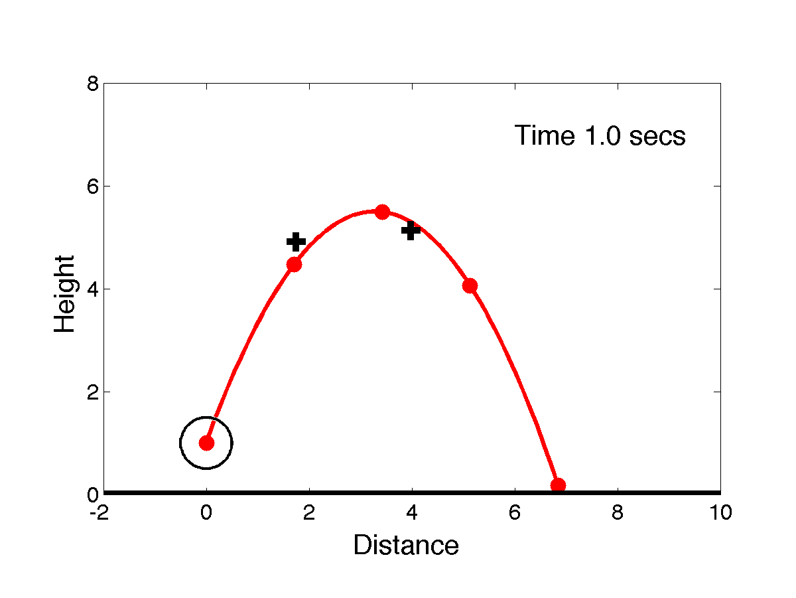
Observations of the Red Ball

Slide 11
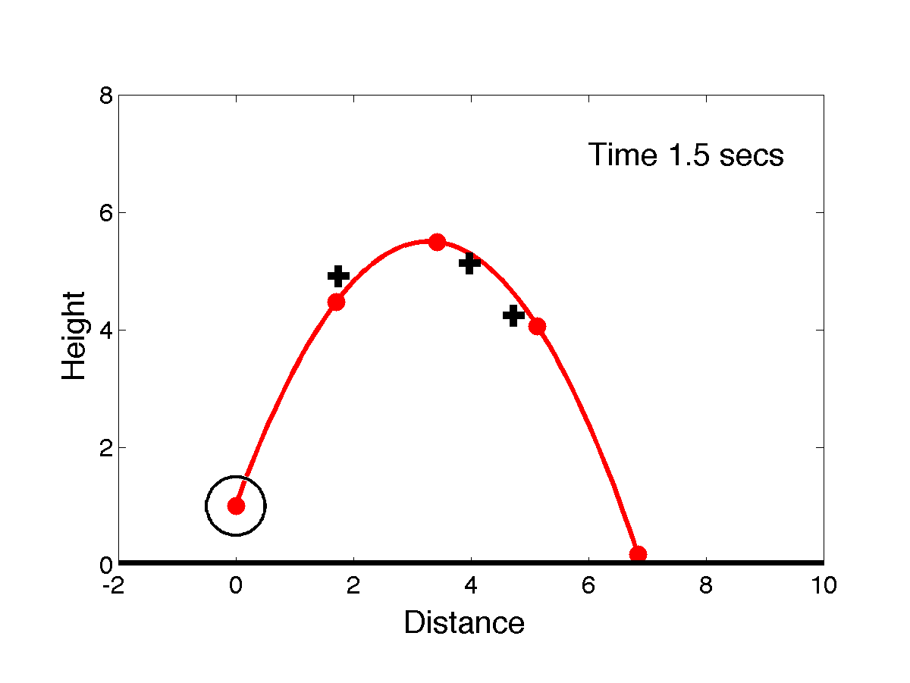
Observations of the Red Ball

Slide 12
Building a Forecast System
Prediction Model
Observing System
Observations
Forecasts
Data Assimilation

Slide 13
Building a Forecast System
Prediction Model
Observing System
Observations
Forecasts
Data Assimilation
Analysis

Slide 14
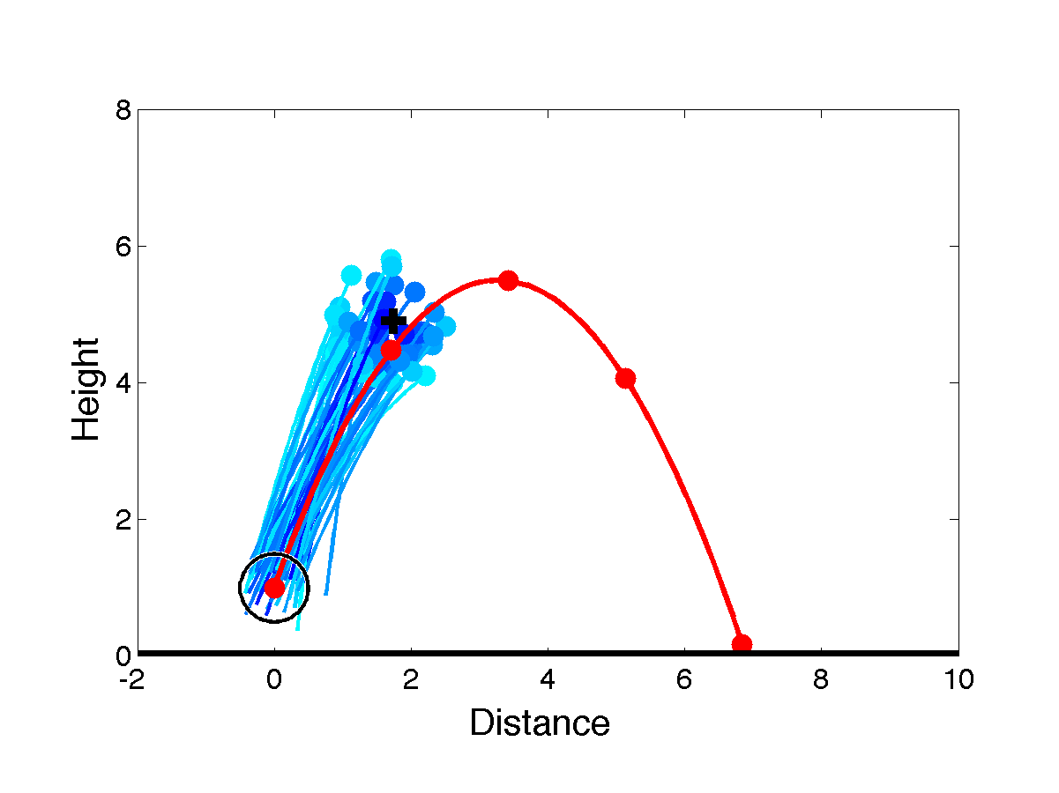
Assimilating the First Observation
Make large ensemble of forecasts.
Closer to observation => more likely.
Fifty likely forecasts are shown (darker blue => more likely).

Slide 15
Assimilating the First Observation
Fifty balls at time 0.5 are an ensemble analysis.
Show uncertainty of best estimate of red ball’s location.

Slide 16
Building a Forecast System
Prediction Model
Observing System
Observations
Forecasts
Initial
Conditions
Data Assimilation
Analysis

Slide 17
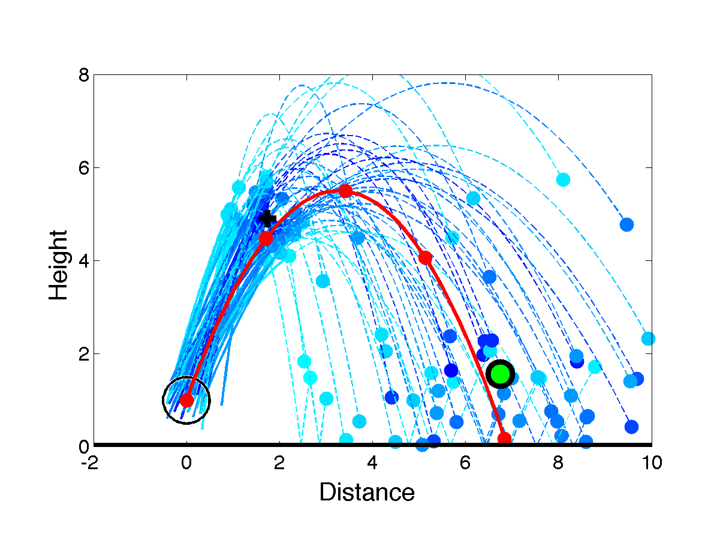
Assimilating the First Observation
Analysis ensemble are initial conditions for 50 forecasts.
Green is weighted mean of ensemble forecast at time 2.0.
This is best single forecast given observations at time 0.5.

Slide 18
Building a Forecast System
Prediction Model
Observing System
Observations
Forecasts
Initial
Conditions
Data Assimilation
Analysis

Slide 19
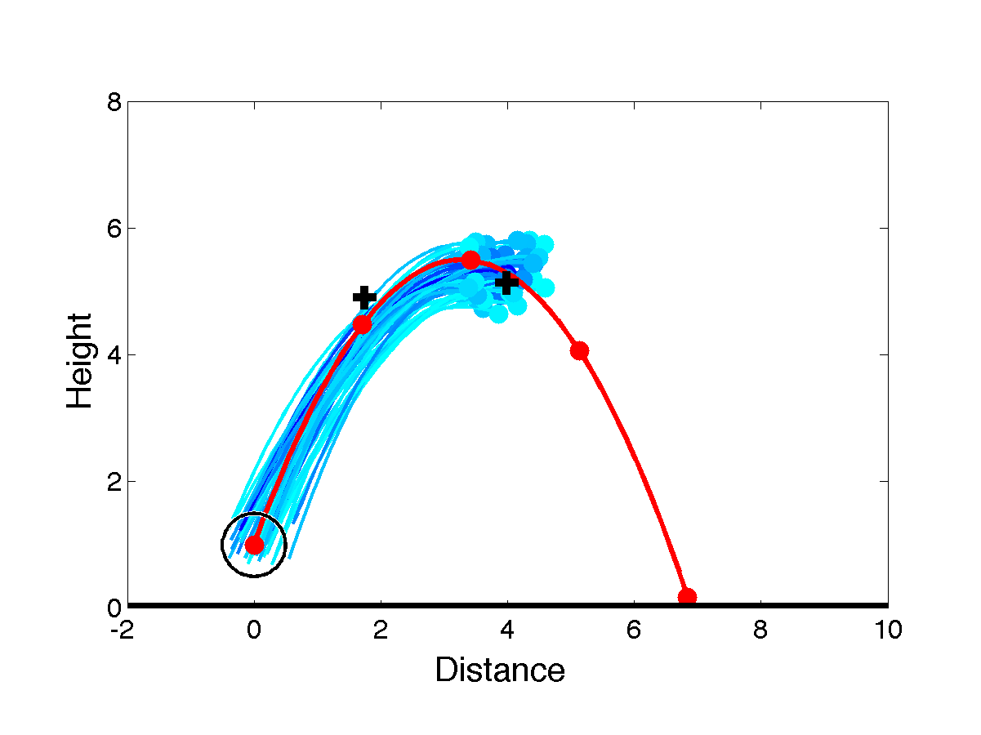
Assimilating the Second Observation
Start with forecast at time 1.0 that used observations at time 0.5.
Add information from observation at time 1.0.

Slide 20
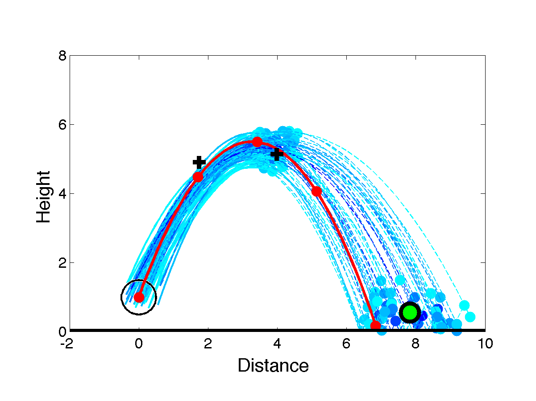
Assimilating the Second Observation
New ensemble analysis is initial conditions for 50 forecasts.
Green is best single forecast of red ball at time 2.0 given observations at time 0.5 and 1.0.

Slide 21
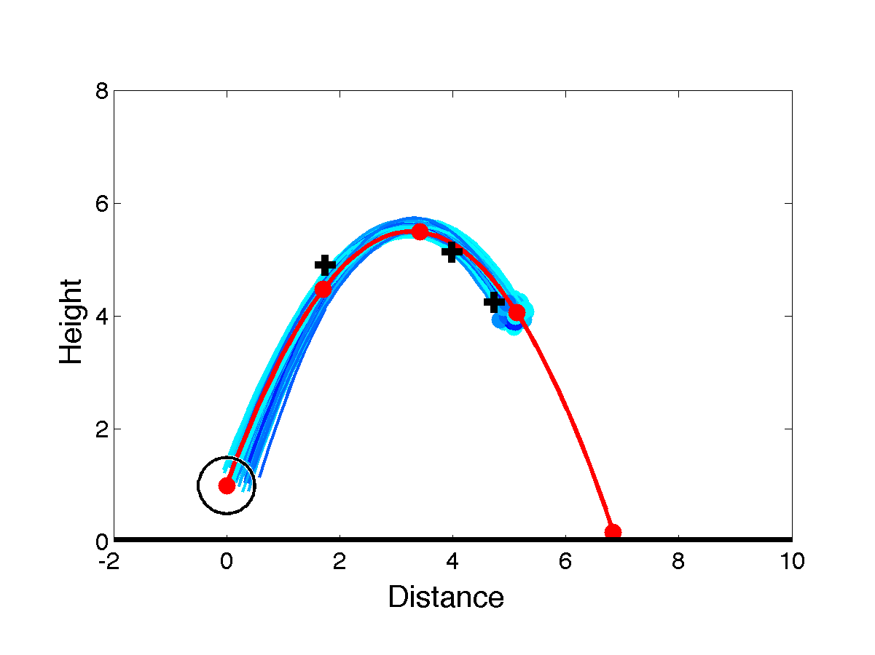
Assimilating the Third Observation
Next ensemble analysis is initial conditions for 50 forecasts.

Slide 22
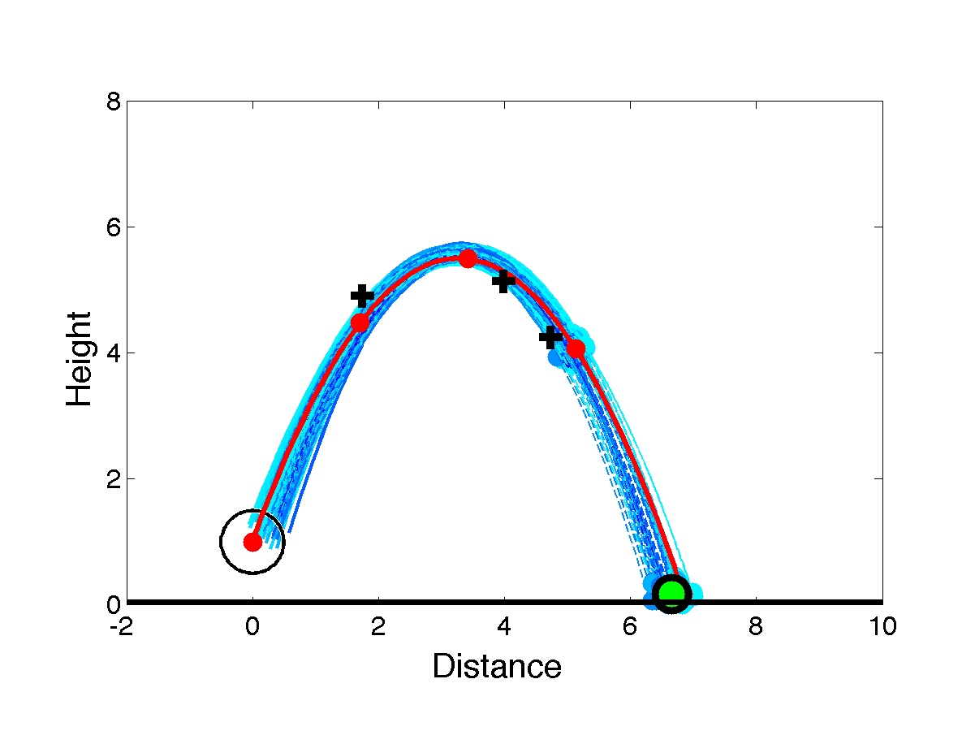
Assimilating the Third Observation
Next ensemble analysis is initial conditions for 50 forecasts.
Green is best single forecast of red ball at time 2.0 given observations at time 0.5, 1.0 and 1.5.

Slide 23
Building a Forecast System
This thrown ball example is in a 2-dimensional space.
Really a 4-dimensional ‘phase’ space including velocity.
Atmosphere, ocean, land, coupled models are BIG.
But they’re still just a ‘ball’ moving in a HUGE phase space.
As many as 100 million dimensions at present.

Slide 24
The Data Assimilation Research Testbed (DART)
DART provides data assimilation ‘glue’ to build state-of-the-art ensemble forecast systems for even the largest models.
Prediction Model
Observing System
DART
Analysis

Slide 25
DART Goals
Provide State-of-the-Art Data Assimilation capability to:
Prediction research scientists,
Model developers,
Observation system developers,
Who may not have any assimilation expertise.

Slide 26
DART Design Constraints
Models small to huge.
Few or many observations.
Tiny to huge computational resources.
Entry cost must be low.
Competitive with existing methods for weather prediction:
Scientific quality of results,
Total computational effort.

Slide 27
A General Description of the Forecast Problem
A system governed by (stochastic) Difference Equation:
(1)
Observations at discrete times:
(2)
Observational error white in time and Gaussian (nice, not essential).
(3)
Complete history of observations is:
(4)
Goal: Find probability distribution for state:
Analysis Forecast (5)
Notes:
s01f01.eps

Slide 28
A General Description of the Forecast Problem
State between observation times obtained from Difference Equation.
Need to update state given new observations:
(6)
Apply Bayes’ rule:
(7)
Noise is white in time (3), so:
(8)
Integrate numerator to get normalizing denominator:
(9)

Slide 29
A General Description of the Forecast Problem
Probability after new observation:
Prior (forecast)
Likelihood
(10)
Posterior (analysis).
Denominator just normalization.

Slide 30
Methods for Solving the Forecast Problem: Particle Filter
Independent evolving estimates,
Associate probability with each estimate given observations,
Eliminate unlikely estimates,
Duplicate likely estimates,
Can represent arbitrary probability distribution,
Scales very poorly for large problems.

Slide 31
Methods for Solving the Forecast Problem: Variational
Four-Dimensional Variational Method:
Minimize a cost function motivated by Eq. 10,
Find optimal fit of evolving model to observations,
Use variational calculus (adjoint) to compute gradient,
State-of-the-art for weather prediction until recently.
Creating model adjoints requires huge effort.
Inconsistent with requirement for easy entry.
Only provides estimate of mean state.

Slide 32
Methods for Solving the Forecast Problem: Kalman Filter
Assumes:
linear model Gaussian noise
Gaussian state
linear forward operator,
Gaussian observation error
Notes:
s01f01.eps

Slide 33
Product of Two Gaussians
Product of d-dimensional normals with means ^{and} ^{and}
^{covariance matrices and} ^{is normal.}

Slide 34
Product of Two Gaussians
Product of d-dimensional normals with means ^{and} ^{and}
^{covariance matrices and} ^{is normal.}
Covariance:
Mean:

Slide 35
Product of Two Gaussians
Product of d-dimensional normals with means ^{and} ^{and}
^{covariance matrices and} ^{is normal.}
Covariance:
Mean:
Weight:
We’ll ignore the weight since we immediately normalize products to be PDFs.

Slide 36
The Kalman Filter
(10)
Numerator is just product of two gaussians.
Denominator just normalizes posterior to be a PDF.

Slide 37
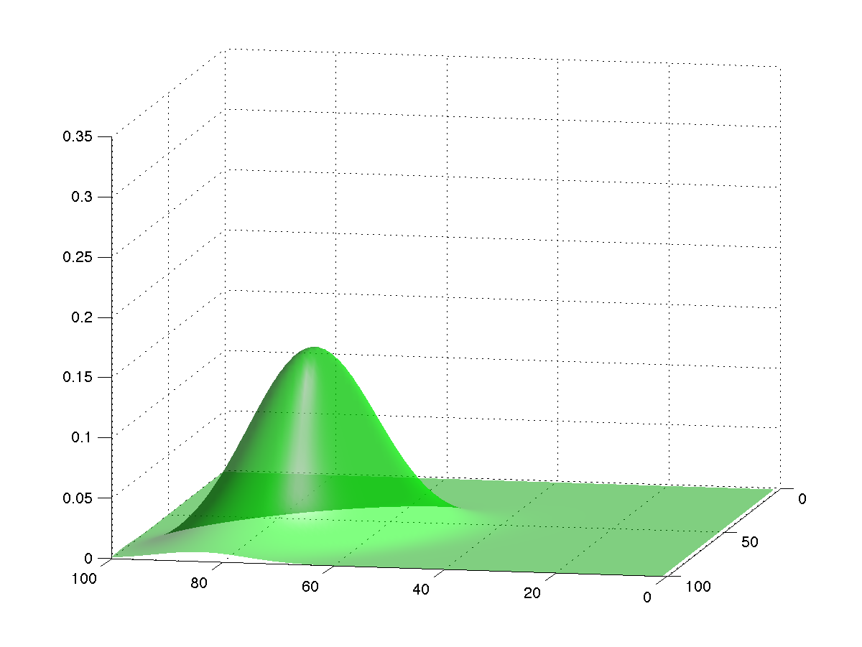
The Kalman Filter
(10)

Slide 38
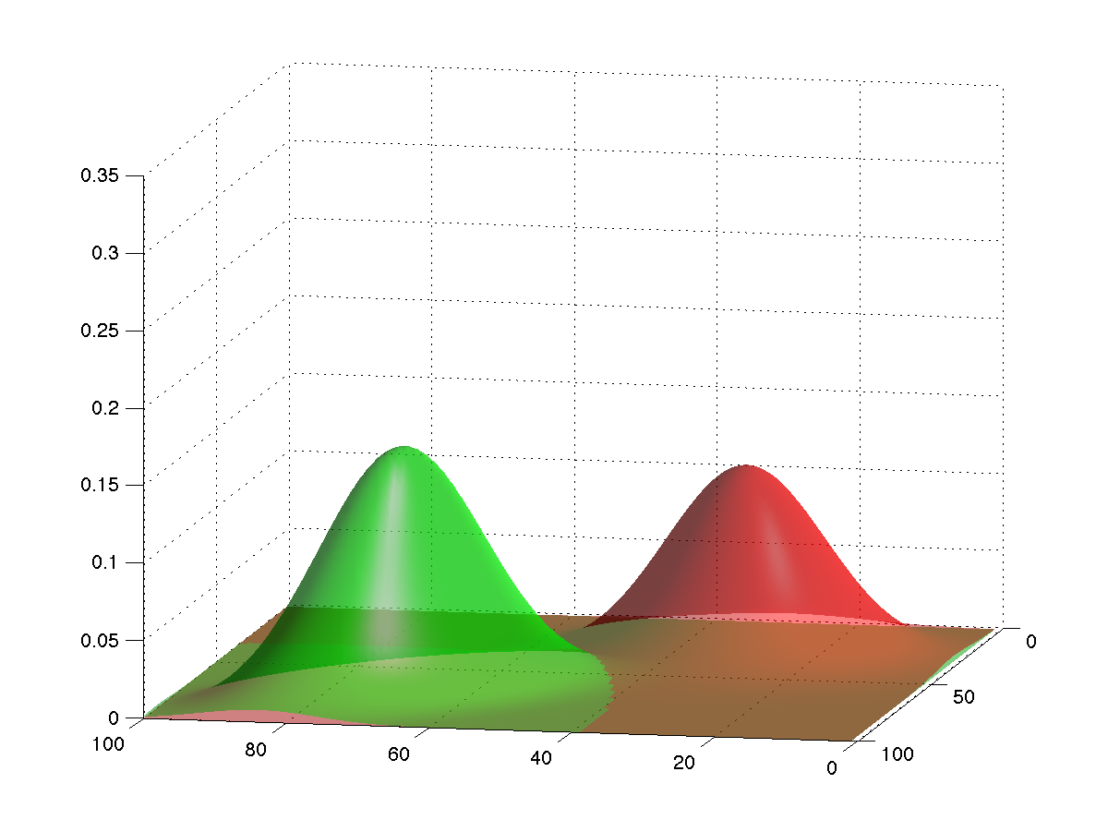
The Kalman Filter
(10)

Slide 39
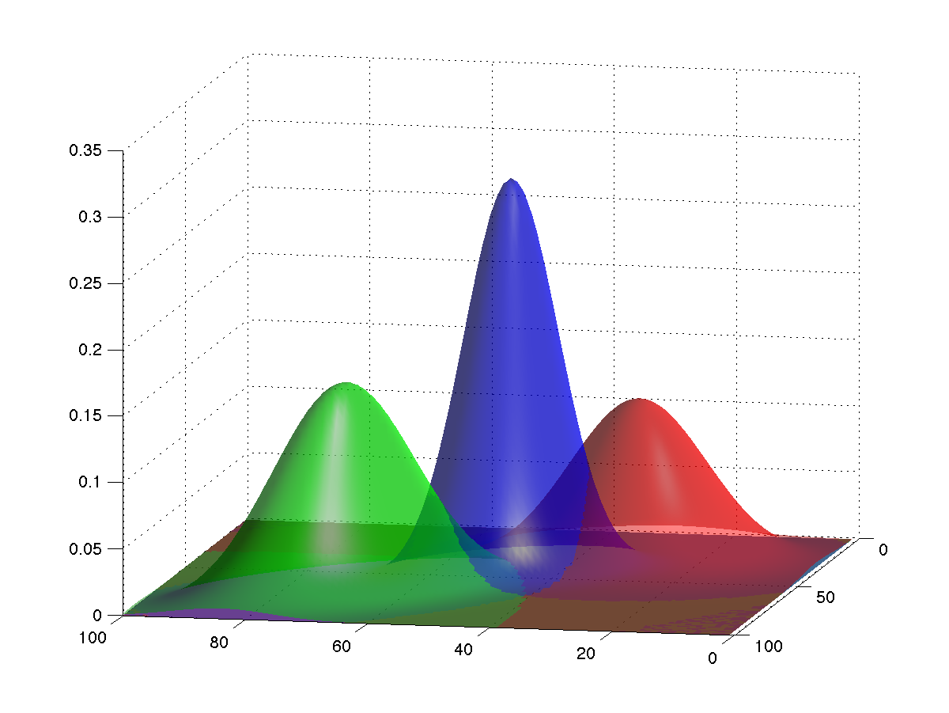
The Kalman Filter
(10)

Slide 40
Kalman Filter: Cost Challenges
Product of d-dimensional normals with means ^{and} ^{and}
^{covariance matrices and} ^{is normal.}
Covariance:
Mean:
Must store and invert covariance matrices.
Too big to store for large problems.
Too costly to invert, > O(n²).

Slide 41
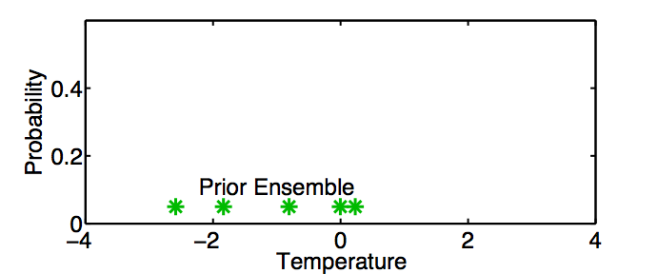
A One-Dimensional Ensemble Kalman Filter
Represent a prior pdf by a sample (ensemble) of N values:
Example: Predict temperature on the Albany campus.

Slide 42
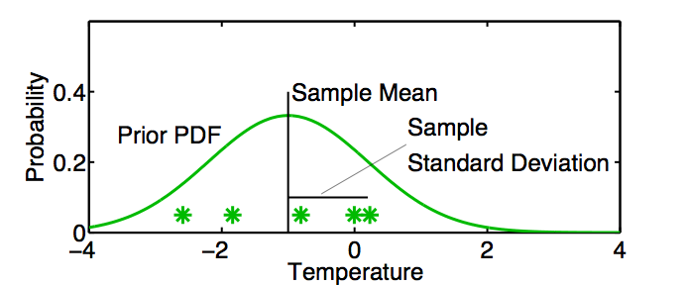
A One-Dimensional Ensemble Kalman Filter
Represent a prior pdf by a sample (ensemble) of N values:
Use sample mean
and sample standard deviation
to determine a corresponding continuous distribution

Slide 43
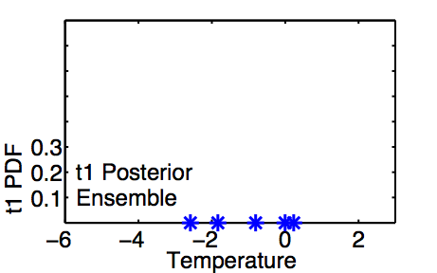
A One-Dimensional Ensemble Kalman Filter: Model Advance
If posterior ensemble at time t₁ is T_{1,n}, n = 1, …, N

Slide 44
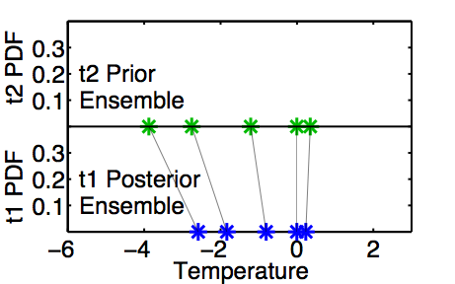
A One-Dimensional Ensemble Kalman Filter: Model Advance
If posterior ensemble at time t₁ is T_{1,n}, n = 1, …, N ,
advance each member to time t₂ with model, T_{2,n} = L(T_{1, n}) n = 1, …,N .

Slide 45
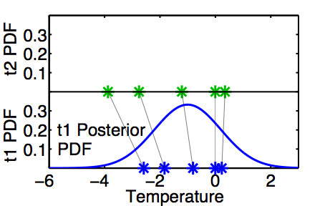
A One-Dimensional Ensemble Kalman Filter: Model Advance
Same as advancing continuous pdf at time t₁ …

Slide 46
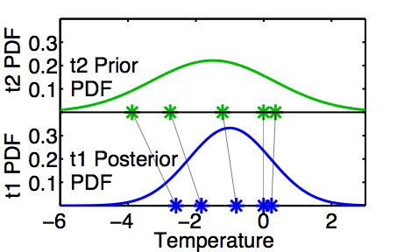
A One-Dimensional Ensemble Kalman Filter: Model Advance
Same as advancing continuous pdf at time t₁
to time t₂ with model L.

Slide 47
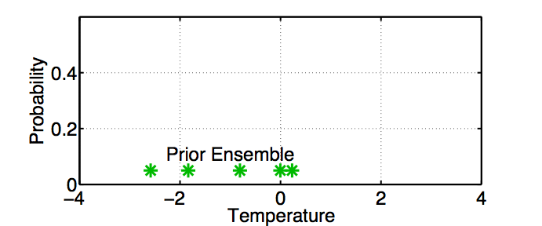
One-Dimensional Ensemble Kalman Filter: Assimilating an Observation

Slide 48
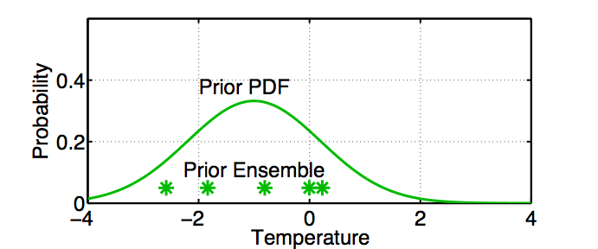
One-Dimensional Ensemble Kalman Filter: Assimilating an Observation
Fit a Gaussian to the sample.

Slide 49
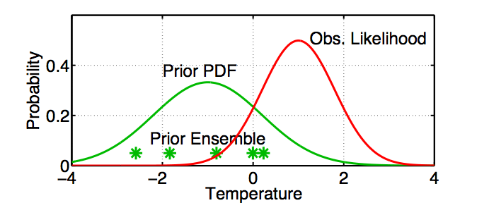
One-Dimensional Ensemble Kalman Filter: Assimilating an Observation
Get the observation likelihood.

Slide 50
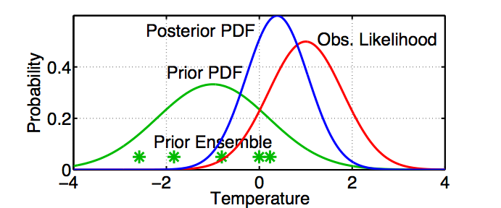
One-Dimensional Ensemble Kalman Filter: Assimilating an Observation
Compute the continuous posterior PDF.

Slide 51
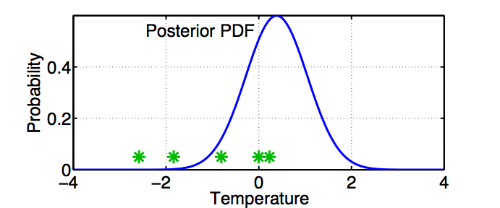
One-Dimensional Ensemble Kalman Filter: Assimilating an Observation
Use a deterministic algorithm to ‘adjust’ the ensemble.

Slide 52
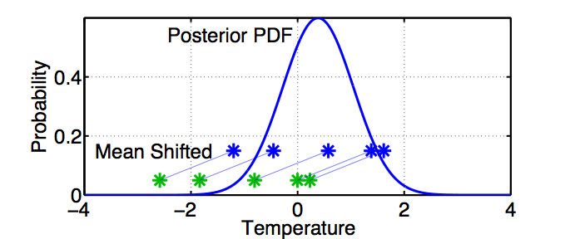
One-Dimensional Ensemble Kalman Filter: Assimilating an Observation
First, ‘shift’ the ensemble to have the exact mean of the posterior.

Slide 53
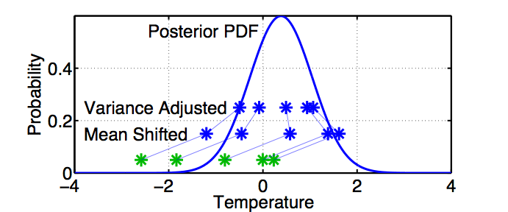
One-Dimensional Ensemble Kalman Filter: Assimilating an Observation
First, ‘shift’ the ensemble to have the exact mean of the posterior.
Second, linearly contract to have the exact variance of the posterior.
Sample statistics are identical to Kalman filter.

Slide 54
Single observed variable, single unobserved variable.
So far, we have a known observation likelihood for a single variable.
Now, suppose the model state has an additional variable,
temperature at Troy.
How should ensemble members update the additional variable?

Slide 55
Ensemble filters: Updating additional prior state variables
Assume that all we know is the prior joint distribution.
One variable is observed.
What should happen to the unobserved variable?
Notes:
s11f01.eps

Slide 56
Ensemble filters: Updating additional prior state variables
Assume that all we know is the prior joint distribution.
One variable is observed.
Update observed variable with ensemble Kalman filter.
Notes:
s11f02.eps

Slide 57
Ensemble filters: Updating additional prior state variables
Assume that all we know is the prior joint distribution.
One variable is observed.
Update observed variable with ensemble Kalman filter.
Notes:
s11f03.eps

Slide 58
Ensemble filters: Updating additional prior state variables
Assume that all we know is the prior joint distribution.
One variable is observed.
Update observed variable with ensemble Kalman filter.
Notes:
s11f04.eps

Slide 59
Ensemble filters: Updating additional prior state variables
Assume that all we know is the prior joint distribution.
One variable is observed.
Compute increments for prior ensemble members of observed variable.
Notes:
s11f06.eps

Slide 60
Ensemble filters: Updating additional prior state variables
Assume that all we know is the prior joint distribution.
One variable is observed.
Compute increments for prior ensemble members of observed variable.
Notes:
s11f07.eps

Slide 61
Ensemble filters: Updating additional prior state variables
Assume that all we know is the prior joint distribution.
One variable is observed.
Compute increments for prior ensemble members of observed variable.
Notes:
s11f08.eps

Slide 62
Ensemble filters: Updating additional prior state variables
Assume that all we know is the prior joint distribution.
One variable is observed.
Compute increments for prior ensemble members of observed variable.
Notes:
s11f09.eps

Slide 63
Ensemble filters: Updating additional prior state variables
Assume that all we know is the prior joint distribution.
One variable is observed.
Compute increments for prior ensemble members of observed variable.
Notes:
s11f010.eps

Slide 64
Ensemble filters: Updating additional prior state variables
Using only increments guarantees that if observation had no impact on observed variable, the unobserved variable is unchanged.
Highly desirable!
Notes:
s11f11.eps

Slide 65
Ensemble filters: Updating additional prior state variables
Assume that all we know is the prior joint distribution.
How should the unobserved variable be impacted?
1st choice: least squares
Equivalent to linear regression.
Same as assuming binormal prior.
Notes:
s11f12.eps

Slide 66
Ensemble filters: Updating additional prior state variables
Have joint prior distribution of two variables.
How should the unobserved variable be impacted?
1st choice: least squares
Begin by finding least squares fit.
Notes:
s11f13.eps

Slide 67
Ensemble filters: Updating additional prior state variables
Have joint prior distribution of two variables.
Next, regress the observed variable increments onto increments for the unobserved variable.
Equivalent to first finding image of increment in joint space.
Notes:
s11f14.eps

Slide 68
Ensemble filters: Updating additional prior state variables
Have joint prior distribution of two variables.
Next, regress the observed variable increments onto increments for the unobserved variable.
Equivalent to first finding image of increment in joint space.
Notes:
s11f15.eps

Slide 69
Ensemble filters: Updating additional prior state variables
Have joint prior distribution of two variables.
Next, regress the observed variable increments onto increments for the unobserved variable.
Equivalent to first finding image of increment in joint space.
Notes:
s11f16.eps

Slide 70
Ensemble filters: Updating additional prior state variables
Have joint prior distribution of two variables.
Next, regress the observed variable increments onto increments for the unobserved variable.
Equivalent to first finding image of increment in joint space.
Notes:
s11f17.eps

Slide 71
Ensemble filters: Updating additional prior state variables
Have joint prior distribution of two variables.
Next, regress the observed variable increments onto increments for the unobserved variable.
Equivalent to first finding image of increment in joint space.
Notes:
s11f18.eps

Slide 72
Ensemble filters: Updating additional prior state variables
Have joint prior distribution of two variables.
Regression: Equivalent to first finding image of increment in joint space.
Then projecting from joint space onto unobserved priors.
Notes:
s11f19.eps

Slide 73
Ensemble filters: Updating additional prior state variables
Have joint prior distribution of two variables.
Regression: Equivalent to first finding image of increment in joint space.
Then projecting from joint space onto unobserved priors.
Notes:
s11f20.eps

Slide 74
Ensemble filters: Updating additional prior state variables
Have joint prior distribution of two variables.
Regression: Equivalent to first finding image of increment in joint space.
Then projecting from joint space onto unobserved priors.
Notes:
s11f21.eps

Slide 75
Ensemble filters: Updating additional prior state variables
Have joint prior distribution of two variables.
Regression: Equivalent to first finding image of increment in joint space.
Then projecting from joint space onto unobserved priors.
Notes:
s11f22.eps

Slide 76
Ensemble filters: Updating additional prior state variables
Have joint prior distribution of two variables.
Regression: Equivalent to first finding image of increment in joint space.
Then projecting from joint space onto unobserved priors.
Notes:
s11f23.eps
Prepare the audience for the next slide. We are going to expand the left marginal at the expense of the other two. The content is the same.

Slide 77
Ensemble filters: Updating additional prior state variables
Now have an updated (posterior) ensemble for the unobserved variable.
Fitting Gaussians shows that mean and variance have changed.
Other features of the prior distribution may also have changed.
Compressed these two.
We’ve expanded this plot. Same information as previous slides.
Compressed these two.
Notes:
s11f24.eps

Slide 78
Ensemble filters: Updating additional prior state variables
Now have an updated (posterior) ensemble for the unobserved variable.
Fitting Gaussians shows that mean and variance have changed.
Other features of the prior distribution may also have changed.
Notes:
s11f25.eps

Slide 79
Ensemble filters: Updating additional prior state variables
Now have an updated (posterior) ensemble for the unobserved variable.
Fitting Gaussians shows that mean and variance have changed.
Other features of the prior distribution may also have changed.
Notes:
s11f26.eps

Slide 80
Properties of Ensemble Kalman Filter
For linear, gaussian problem:
If, ensemble size N>N_{crit}
Mean and covariance are identical to Kalman Filter,
Else
Diverges.
Ncrit: Number of positive singular values in SVD of covariance matrix.
Notes:
s11f26.eps

Slide 81
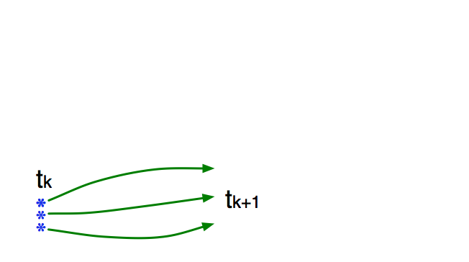
How an Ensemble Filter Works for Geophysical Data Assimilation
Use model to advance ensemble (3 members here) to time at which next observation becomes available.
Ensemble state estimate after using previous observation (analysis)
Ensemble state at time of next observation (prior)

Slide 82
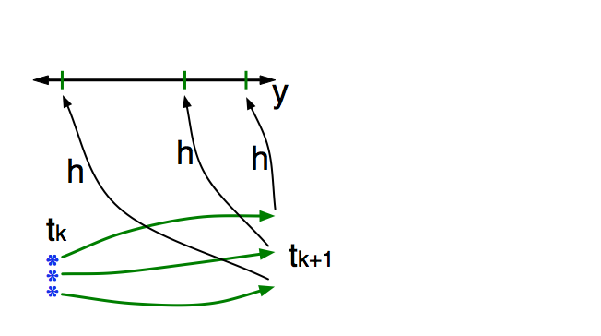
How an Ensemble Filter Works for Geophysical Data Assimilation
Get prior ensemble sample of observation, y = h(x), by applying forward operator h to each ensemble member.
Theory: observations from instruments with uncorrelated errors can be done sequentially.

Slide 83
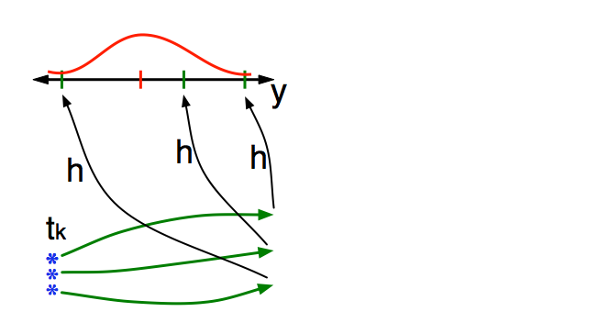
How an Ensemble Filter Works for Geophysical Data Assimilation
Get observed value and observational error distribution from observing system.

Slide 84
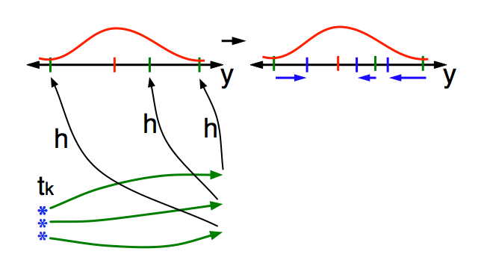
How an Ensemble Filter Works for Geophysical Data Assimilation
Find the increments for the prior observation ensemble (this is a scalar problem for uncorrelated observation errors).

Slide 85
How an Ensemble Filter Works for Geophysical Data Assimilation
Find the increments for the prior observation ensemble (this is a scalar problem for uncorrelated observation errors).
Note: Difference between various ensemble filter methods is primarily in observation increment calculation.

Slide 86
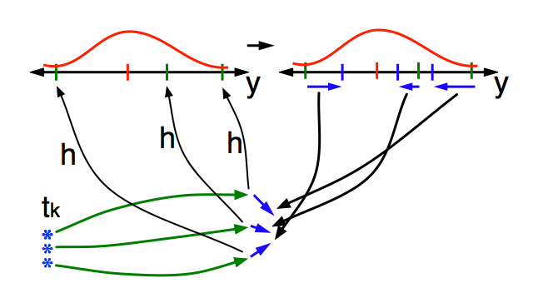
How an Ensemble Filter Works for Geophysical Data Assimilation
Use ensemble samples of y and each state variable to linearly regress observation increments onto state variable increments.

Slide 87
How an Ensemble Filter Works for Geophysical Data Assimilation
Use ensemble samples of y and each state variable to linearly regress observation increments onto state variable increments.
Theory: impact of observation increments on each state variable can be handled independently!

Slide 88
How an Ensemble Filter Works for Geophysical Data Assimilation
Use ensemble samples of y and each state variable to linearly regress observation increments onto state variable increments.
DART updates all state variables in parallel. Variables randomly assigned to processes for load balancing.

Slide 89
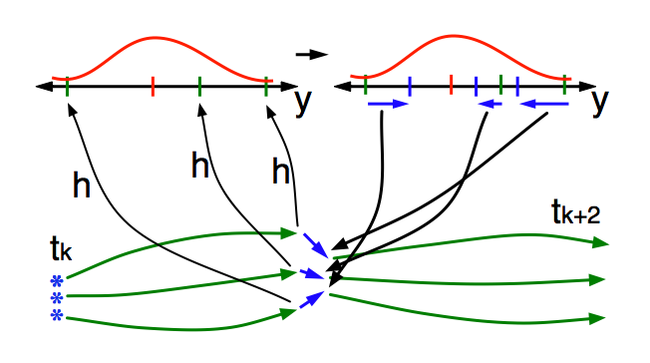
How an Ensemble Filter Works for Geophysical Data Assimilation
When all ensemble members for each state variable are updated, integrate to time of next observation …

Slide 90
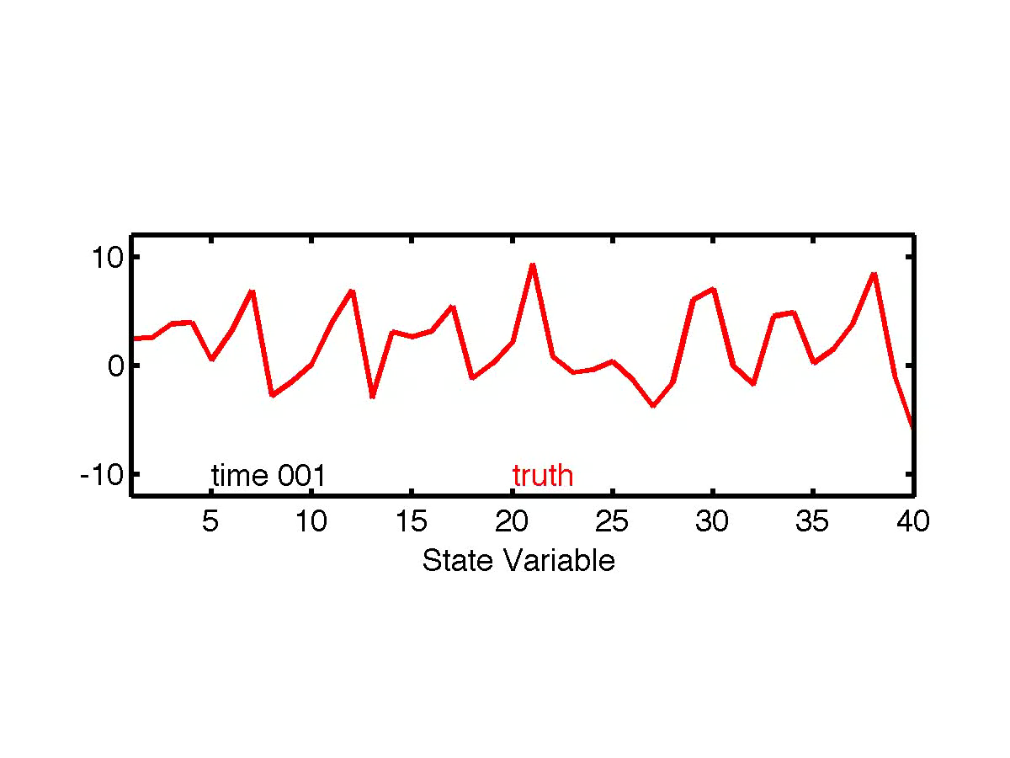
Ensemble Filter for Lorenz-96 40-Variable Model
40 state variables: X₁, X₂,..., X₄₀.
dX_{i} / dt = (X_{i+1} - X_{i-2})X_{i-1} - X_{i} + F.
Acts ‘something’ like weather around a latitude band.

Slide 91
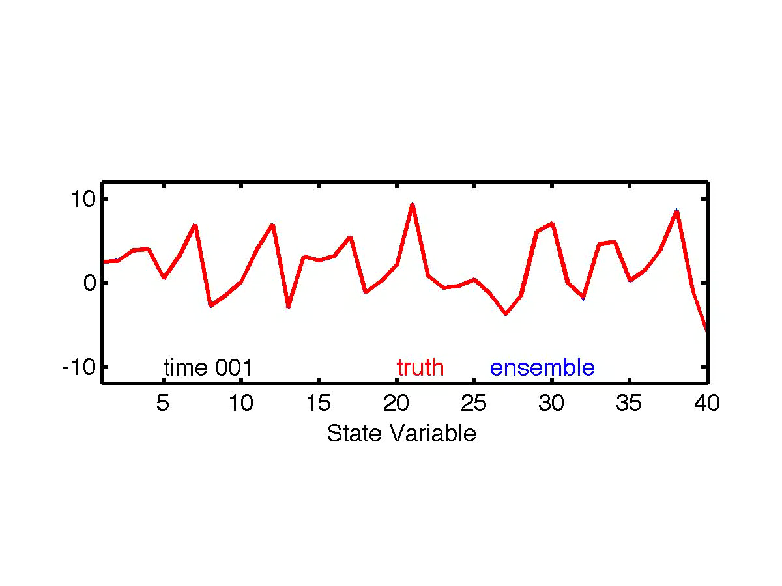
Lorenz-96 is sensitive to small perturbations
Introduce 20 ‘ensemble’ state estimates.
Each is perturbed for each of the 40-variables at time 0.
Refer to unperturbed control integration as ‘truth’.

Slide 92
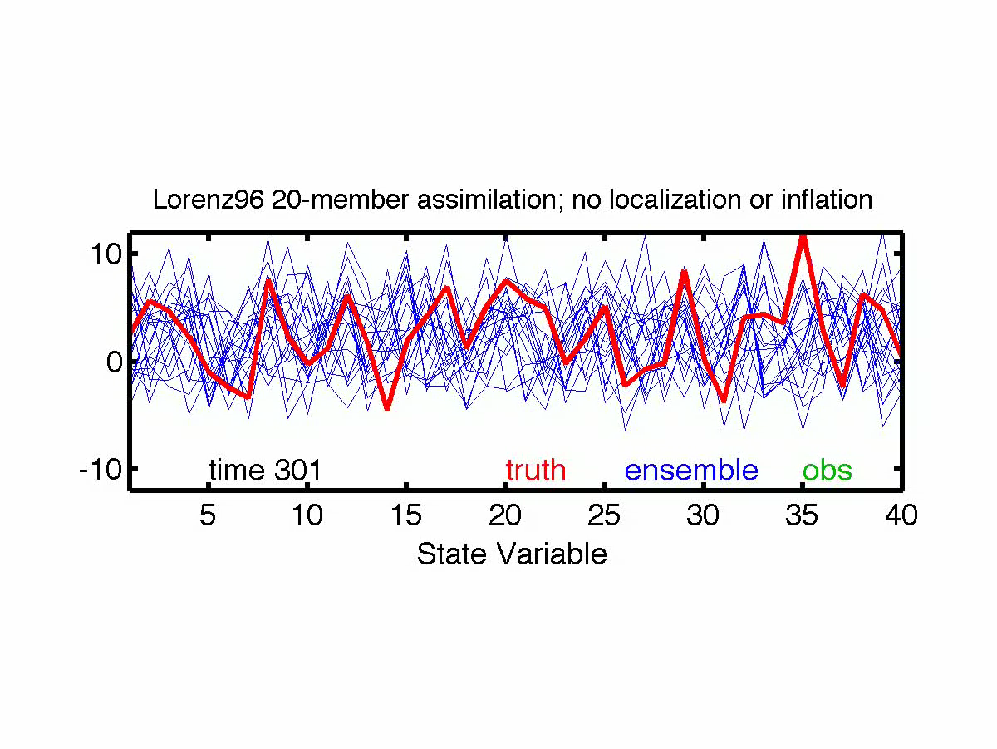
Assimilate ‘observations’ from 40 random locations.
Interpolate truth to station location.
Simulate observational error:
Add random draw from N(0, 16) to each.
Start from ‘climatological’ 20-member ensemble.

Slide 93
Some Error Sources in Ensemble Filters
3. Observation error
4. Sampling Error;
Gaussian Assumption
2. Obs. operator error;
Representativeness
5. Sampling Error;
Assuming Linear
Statistical Relation
1. Model error

Slide 94
Sampling Error: Observations Impact Unrelated State Variables
Plot shows expected absolute value of sample correlation vs. true correlation.
Unrelated obs. reduce spread, increase error.
Attack with localization.
Reduce impact of observation on weakly correlated state variables.
Let weight go to zero for many ‘unrelated’ variables to save on computing.

Slide 95
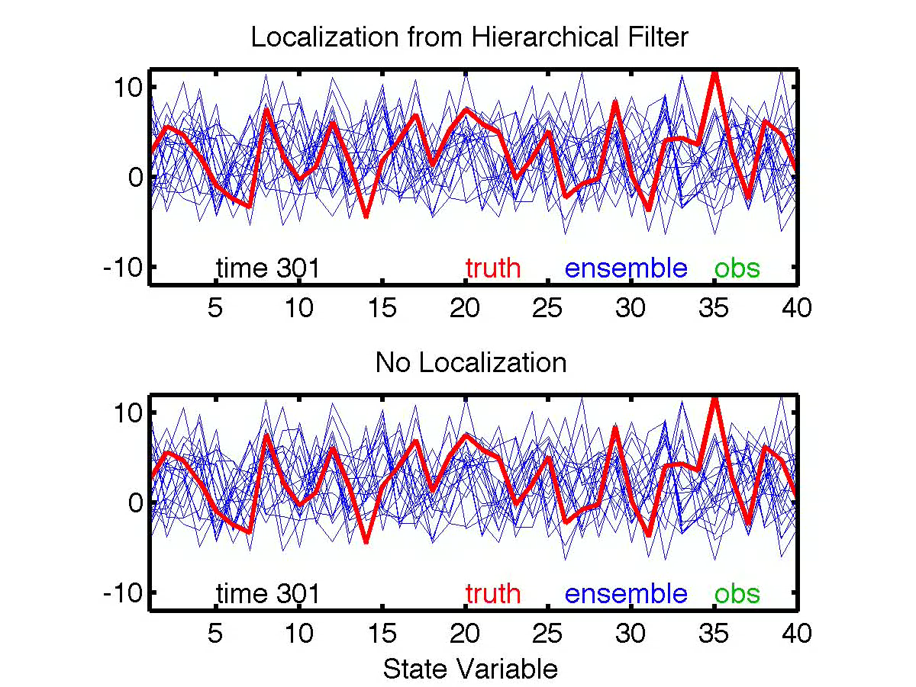
Lorenz-96 Assimilation with localization of observation impact

Slide 96
Lorenz-96 Assimilation with localization of observation impact

Slide 97
Some Error Sources in Ensemble Filters
3. Observation error
4. Sampling Error;
Gaussian Assumption
2. Obs. operator error;
Representativeness
5. Sampling Error;
Assuming Linear
Statistical Relation
1. Model error

Slide 98
Assimilating in the presence of simulated model error
dXi / dt = (Xi+1 - Xi-2)Xi-1 - Xi + F.
For truth, use F = 8.
In assimilating model, use F = 6.
Time evolution for first state variable shown.
Assimilating model quickly diverges from ‘true’ model.

Slide 99
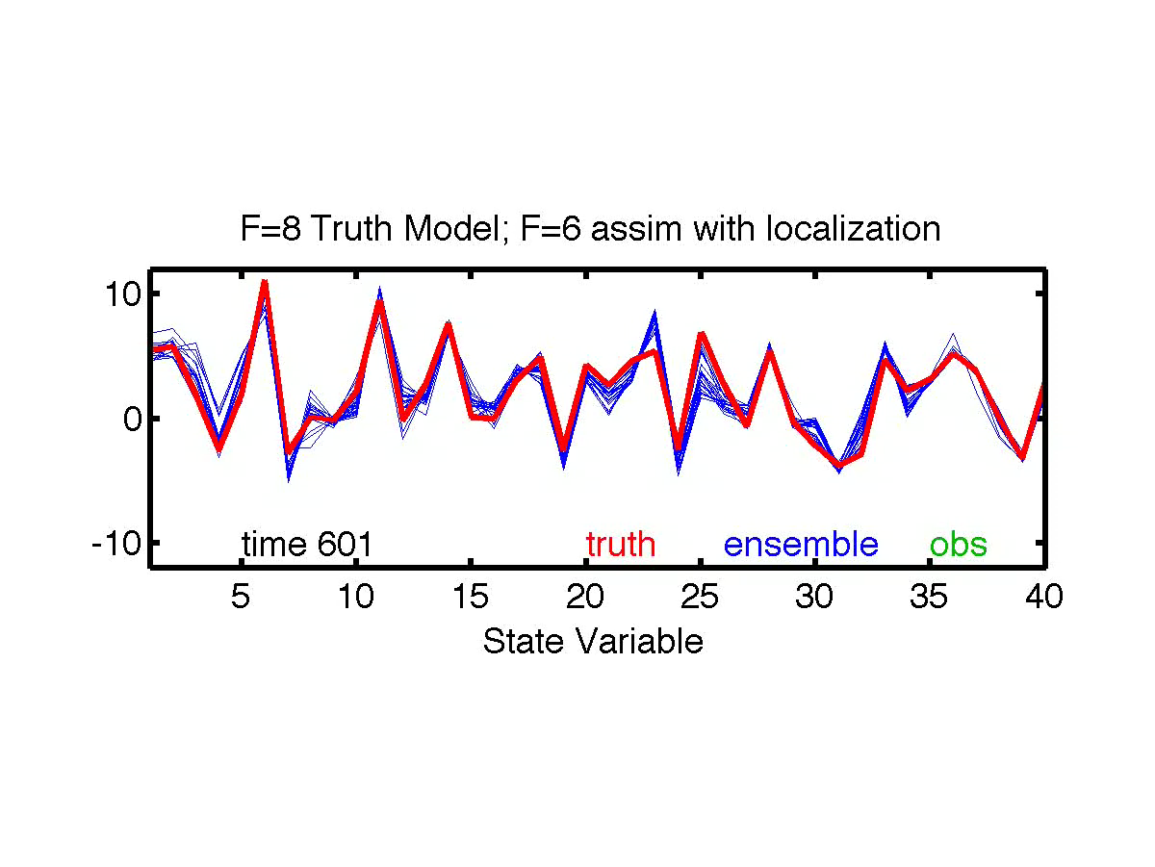
Assimilating in the presence of simulated model error
dXi / dt = (Xi+1 - Xi-2)Xi-1 - Xi + F.
For truth, use F = 8.
In assimilating model, use F = 6.

Slide 100
Reduce confidence in prior to deal with model error
Use inflation.
Simply increase prior ensemble variance for each state variable.
Adaptive algorithms use observations to guide this.

Slide 101
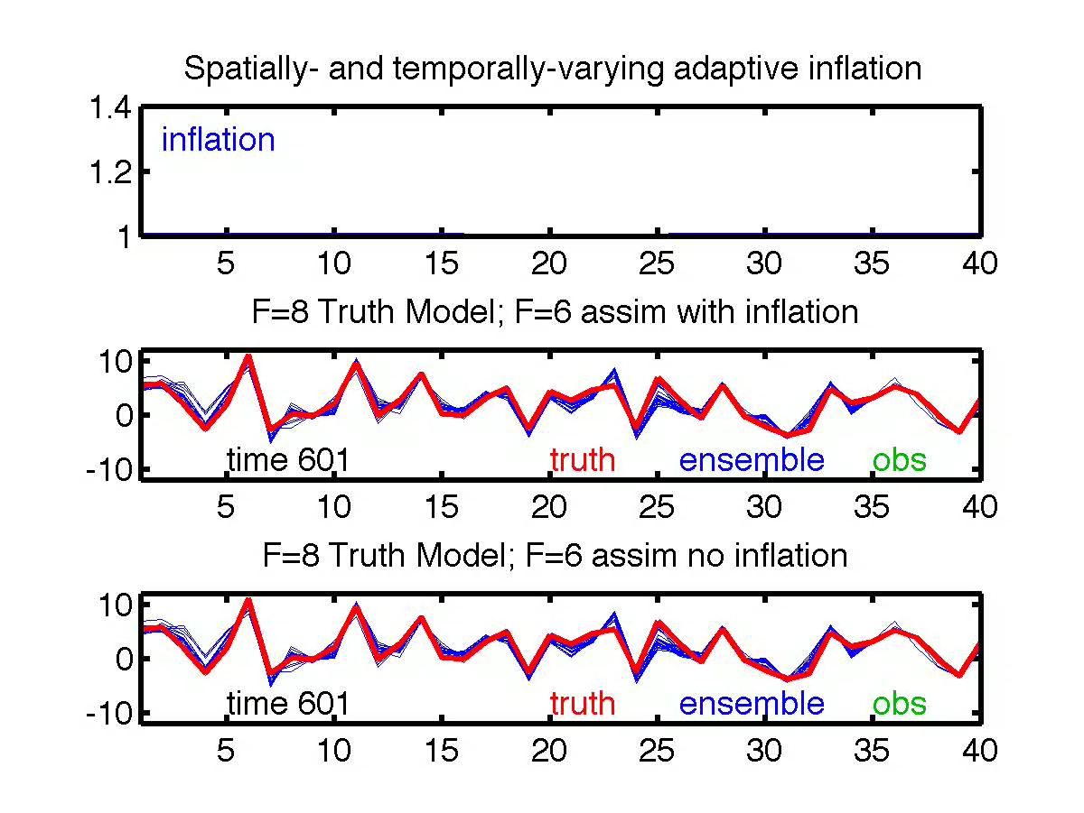
Assimilating with Inflation in Presence of Model Error
Inflation is a function of state variable and time.
Automatically selected by adaptive inflation algorithm.

Slide 102
Uncertainty Quantification with an Ensemble Kalman Filter
(Ensemble) KF optimal for linear model, gaussian likelihood, perfect model.
In KF, only mean and covariance have meaning.
Ensemble allows computation of many other statistics.
What do they mean? Not entirely clear.
What do they mean when there are all sorts of error?
Even less clear.
Must Calibrate and Validate results.

Slide 103
The Data Assimilation Research Testbed (DART)
DART provides data assimilation ‘glue’ to build ensemble forecast systems for the atmosphere, ocean, land, …
Prediction Model
Observing System
DART
Analysis
Diagnostics

Slide 104
DART Science and Collaborators (1)
Science: A global atmospheric ensemble reanalysis.
Collaborators: Model Developers at NCAR
Assimilation uses 80 members of 2º FV CAM forced by a single ocean (Hadley+ NCEP-OI2) and produces a very competitive reanalysis.
O(1 million) atmospheric obs are assimilated every day.
500 hPa GPH
Feb 17 2003
1998-2010
4x daily
is available.

Slide 105
DART Science and Collaborators (2)
Science: Do new satellite observations of cloud motion improve hurricane forecasts?
Atmospheric motion vectors from CIMMS at University of Wisconsin.
Collaborator: Ting-Chi Wu,
Graduate Student,
University of Miami.

Slide 106
DART Science and Collaborators (2)
Tropical Cyclones and Atmospheric Motion Vectors
Wu et al., 2014, MWR, 142, 49–71.

Slide 107
DART Science and Collaborators (3)
Science: Where should more observations be taken to
improve landfall forecasts?
Ensemble sensitivity analysis for Katrina.
Collaborator: Ryan Torn, University at Albany.

Slide 108
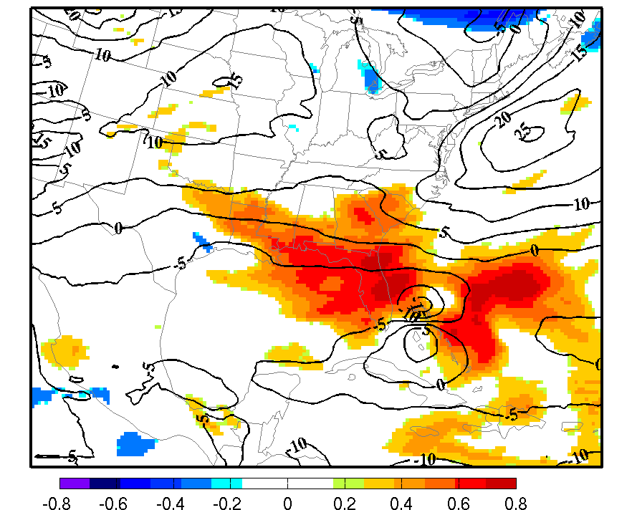
DART Science and Collaborators (3)
Hurricane Katrina Sensitivity Analysis
Contours are ensemble mean 48h forecast of deep-layer mean wind.
Color shows where observations could help.

Slide 109
Identifying Model Systematic Errors
Prediction Model
Observing System
Identify
Systematic
Errors
Data Assimilation
Analysis
Diagnostics

Slide 110
DART Science and Collaborators (4)
Science: Diagnosing and correcting errors in the CAM FV core.
Collaborator: Peter Lauritzen, CGD.

Slide 111
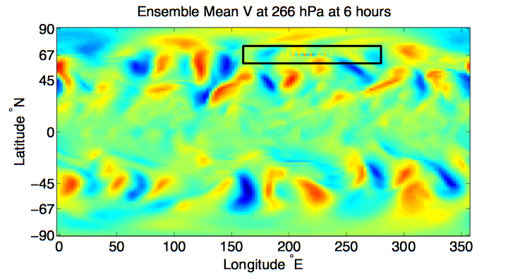
DART Science and Collaborators (4)
Gridpoint noise detected in CAM/DART analysis
CAM FV core - 80 member mean - 00Z 25 September 2006

Slide 112
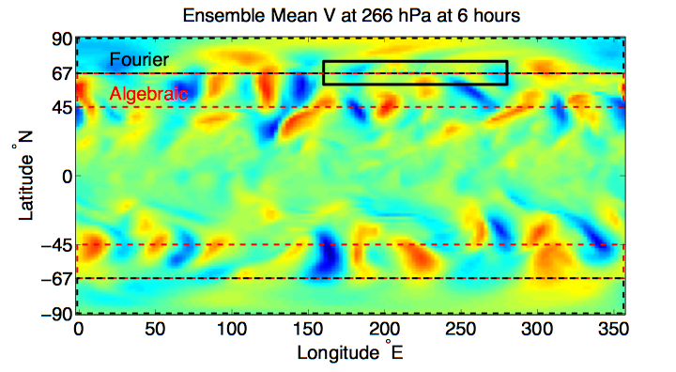
DART Science and Collaborators (4)
Suspicions turned to the polar filter (DPF)
CAM FV core - 80 member mean - 00Z 25 September 2006

Slide 113
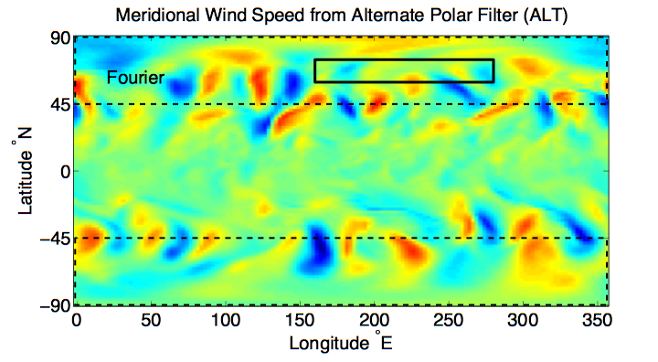
DART Science and Collaborators (4)
Continuous polar filter (alt-pft) eliminated noise.

Slide 114
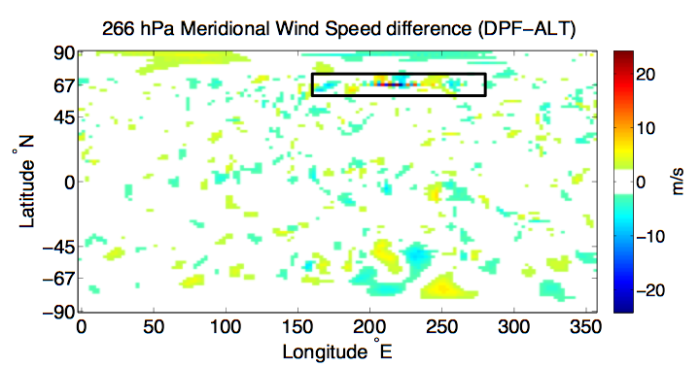
DART Science and Collaborators (4)
Differences mostly in transition region of default filter.

Slide 115
DART Science and Collaborators (4)
The use of DART diagnosed a problem that had been unrecognized (or at least undocumented).
Could have an important effect on any physics in which meridional mixing is important.
The problem can be seen in ‘free runs’ - it is not a data assimilation artifact.
Without assimilation, can’t get reproducing occurrences to diagnose.

Slide 116
DART Science and Collaborators (5)
Science: Global Ocean data assimilation.
Collaborators: Alicia Karspeck, Steve Yeager, CGD.
Climate change over time scales of 1 to several decades has been identified as very important for mitigation and infrastructure planning.
Need ocean initial conditions for the IPCC decadal prediction program (and maybe a crystal ball, too!).

Slide 117
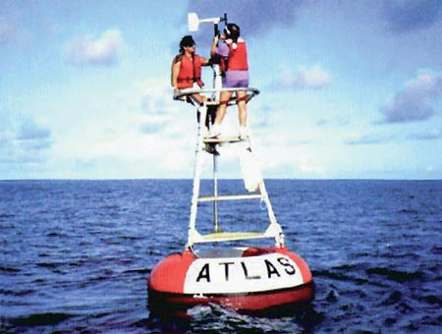
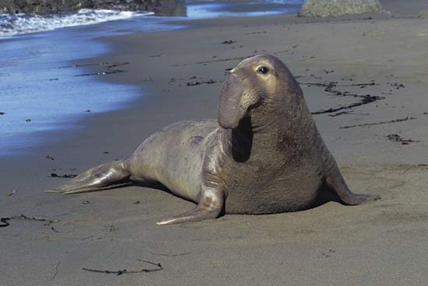
DART Science and Collaborators (5)
World Ocean Database T, S observation counts.
These counts are for 1998 & 1999 and are representative.
FLOAT_SALINITY 68200
FLOAT_TEMPERATURE 395032
DRIFTER_TEMPERATURE 33963
MOORING_SALINITY 27476
MOORING_TEMPERATURE 623967
BOTTLE_SALINITY 79855
BOTTLE_TEMPERATURE 81488
CTD_SALINITY 328812
CTD_TEMPERATURE 368715
STD_SALINITY 674
STD_TEMPERATURE 677
XCTD_SALINITY 3328
XCTD_TEMPERATURE 5790
MBT_TEMPERATURE 58206
XBT_TEMPERATURE 1093330
APB_TEMPERATURE 580111

Slide 118
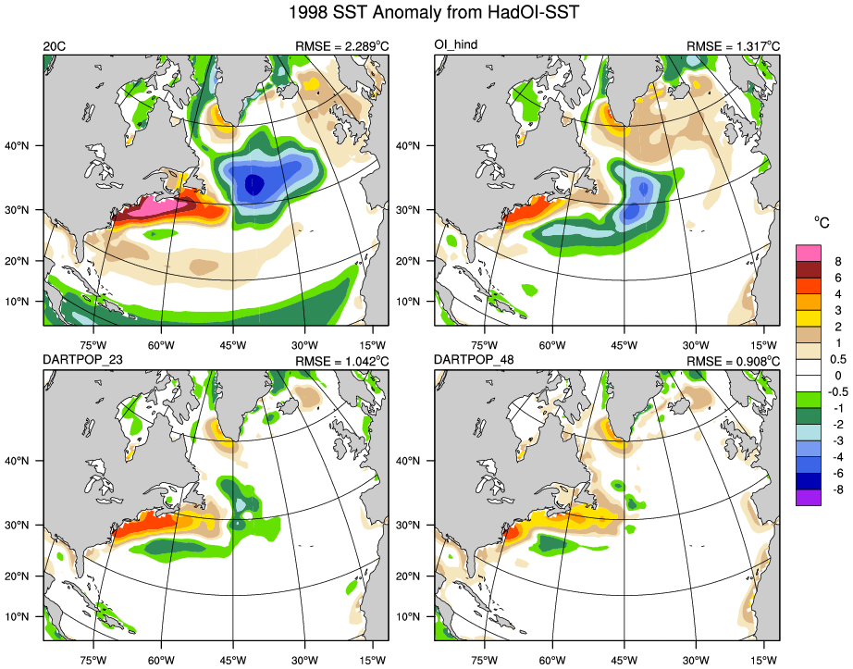
Physical Space: 1998/1999 SST Anomaly from HadOI-SST
Coupled Free Run
POP forced by observed atmosphere (hindcast)
48 POP 48 CAM
23 POP 1 DATM

Slide 119
DART Science and Collaborators (6)
Science: Land surface analysis with DART/CLM.
Collaborator: Yongfei Zhang, UT Austin.
Land surface analysis with DART/CLM:
Estimate snow water equivalent with observations
of snow cover fraction from satellites (MODIS).

Slide 120
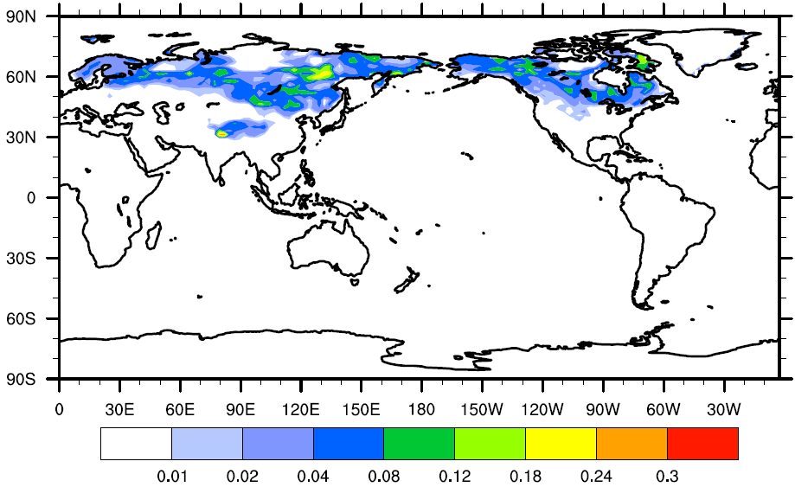
Assimilation of MODIS snow cover fraction
80 member ensemble for onset of NH winter
Assimilate once per day
Level 3 MODIS product – regridded to a daily 1 degree grid
Observation error variance is 0.1 (for lack of a better value)
Observations can impact state variables within 200km
CLM variable to be updated is the snow water equivalent “H2OSNO”
Standard deviation of the snow cover fraction initial conditions for Oct. 2002

Slide 121
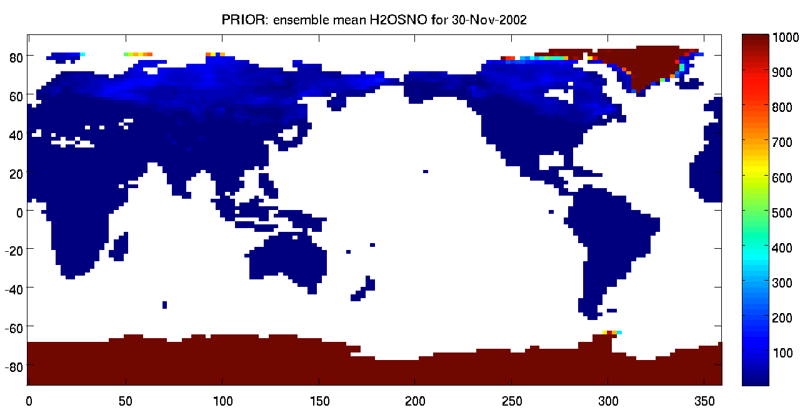


An early result: assimilation of MODIS snowcover fraction on total snow water equivalent in CLM.
Thanks Yongfei!
kg/m2
Prior for Nov 30, 2002
kg/m2
Increments (Prior – Posterior)
The model state is changing in reasonable places, by reasonable amounts. At this point, that’s all we’re looking for.
Focus on the non-zero increments

Slide 122
DART Science and Collaborators (7)
Science: Regional Atmospheric Chemistry.
Collaborator: Arthur Mizzi, NCAR/ACD.

Slide 123
WRF/Chem Chemical Weather Forecast System
WRF-Chem – Weather Research and Forecasting Model (WRF) with online chemistry.
Meteorological Observations – NOAA PREPBUFR conventional observations.
Chemistry Observations – MOPITT CO retrieval profiles (also IASI CO retrievals – results not shown).

Slide 124
WRF/Chem Chemical Weather Forecast System
WRF/Chem-DART cycling with conventional meteorological observations and MOPITT CO V5 retrieval profiles.
Continuous six-hr cycling (00Z, 06Z, 12Z, and 18Z).
CONUS grid with 101x41x34 grid points and 100 km resolution.
20-member ensemble.
June 1 - 30, 2008 (112 cycles) study period.
Full state variable/obs interaction.
Initial and lateral chemical boundary conditions from MOZART-4 simulation.
Emissions: Biogenic – MEGAN, Anthropogenic – global inventories, and Fire – Fire Inventory from NCAR (FINN).

Slide 125
WRF/Chem Chemical Weather Forecast System
Two experiments:
Exp 1: PREPBUFR conventional obs (CNTL DA).
Exp 2: MOPITT CO retrieval profiles and PREPBUFR conventional obs (CHEM DA).

Slide 126
WRF/Chem Chemical Weather Forecast System

Slide 127
DART Science and Collaborators (8)
Science: Global Atmospheric Chemistry.
Collaborators: Jerome Barre,
Benjamin Gaubert, NCAR/ACD.
Uses global CAM/Chem model, 1 degree.
Have full meteorological assimilation capability already.

Slide 128

CAM/Chem Chemical DA System
MOPITT CO:
On TERRA satellite
tropospheric profiles
Global coverage in 4 days
Multispectral retrievals
high sensitivity on surface land/day
IASI CO:
On MetOpA satellite
tropospheric profiles
Global coverage in 1 day
Only thermal infrared
Sensitivity on upper PBL &
mid troposphere
Notes:
Now we want to evaluate the chemical data assimailtion system.
As CO observation we have used MOPITT CO on terra that retrive a troposphere profile
It covers the globe in 4 days
On the other hand we have also assimilated iasi CO, on metopa
Iasi has a larger swath and covers the globe in 1 day
This is not a multispectral instrument then it has less sensitivity in the lowermost troposphere over land

Slide 129




CAM/Chem Chemical DA System
Control run: Met Only assimilated
MOPITT run: Met + MOPITT assimilated
IASI run: Met + IASI assimilated
Combined run: Met + MOP+ IASI assimilated
Notes:
So we perform 4 experiments
A control run with only meteorology assimilated
A mopitt run where we add mopitt assimialtion
A iasi run where we add iasi assimialtion
And also a combined run
CO assimilation globally increases CO. the effect of mopitt Is lower than the effect of iasi and that could easily be explained by the denser data coverage of iasi.
When the two instruments are asimialted, the combined run look very similar to the iasi run.

Slide 130
Parameter Estimation
A system governed by (stochastic) Difference Equation:
(1)
Observations at discrete times:
(2)
Observational error white in time and Gaussian (nice, not essential).
(3)
Complete history of observations is:
(4)
Goal: Find probability distribution for state:
Analysis Forecast (5)
Notes:
s01f01.eps

Slide 131
Parameter Estimation
A system governed by (stochastic) Difference Equation:
(1)
Notes:
s01f01.eps

Slide 132
Parameter Estimation
A system governed by (stochastic) Difference Equation:
(1)
Most geophysical models have ‘tuning’ parameters.
Model prediction might also depend on ‘external forcing’.
Example: Sources of chemical tracers.
Notes:
s01f01.eps

Slide 133
Parameter Estimation
A system governed by (stochastic) Difference Equation:
(1)
One solution: State augmentation.
Define extended state vector
Prediction model becomes (just a change in notation):
Notes:
s01f01.eps

Slide 134
Parameter Estimation
Define extended state vector
Prediction model becomes:
Problem: In general, no time prediction model for parameters.
If we had a prediction model, they would just have been state.
Kalman filter prior covariance comes from prediction model.
Notes:
s01f01.eps

Slide 135
Parameter Estimation
Define extended state vector
Prediction model becomes:
Prior ensembles for parameters must be specified.
The prior sample covariance controls the impact of observations
on parameters.
If prior covariance is not well-known, estimating parameters can be
challenging.
Notes:
s01f01.eps

Slide 136



Learn more about DART at:
www.image.ucar.edu/DAReS/DART
dart@ucar.edu
Anderson, J., Hoar, T., Raeder, K., Liu, H., Collins, N., Torn, R., Arellano, A., 2009: The Data Assimilation Research Testbed: A community facility.
BAMS, 90, 1283—1296, doi: 10.1175/2009BAMS2618.1

